Slide 1
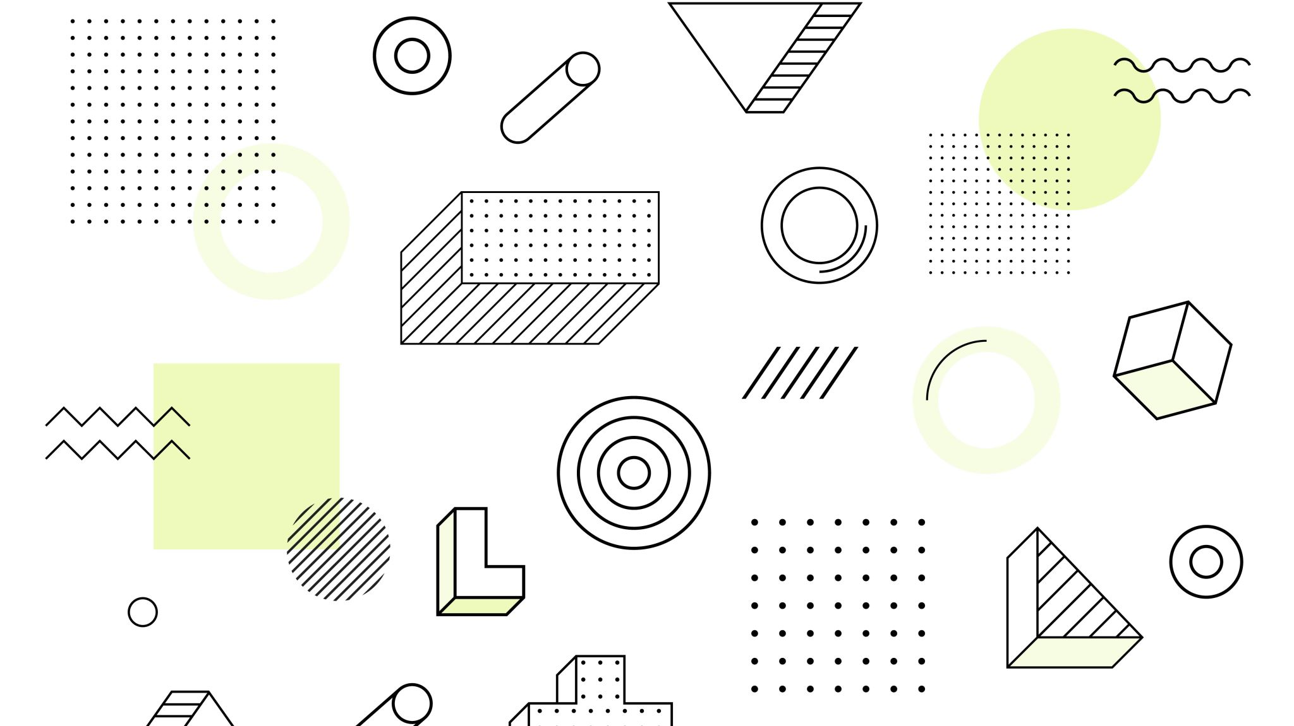
Block Moving Project
Foundation of Artificial Intelligence

Slide 2
Introduction
In this project, I have created two robotic arms, which will be used for picking up one to ten blocks from one location(l2) and place it on other location(l1).
Apart from placing on a location, the arms will be used to stack one block on the other.
Furthermore each robotic arm will be performing one action on one box at a time.
Moreover the robotic arms are having the grasping capacity, with which they will be performing: PICK-UP, PUT-DOWN,STACK,MOVE,UNSTACK,NOOP.

Slide 3
Environment
Microsoft windows 2010
Visual studio 2019
Language C++

Slide 4
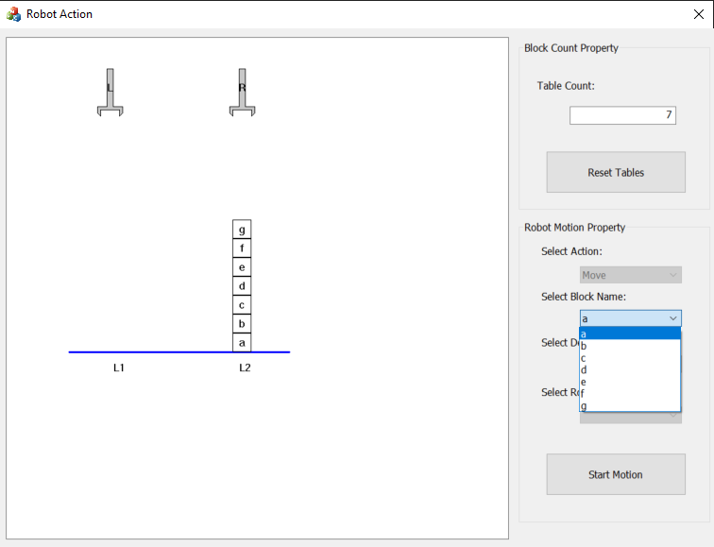
Here, you can enter the desired number of boxes you want on the table
From, the following drop-down box, you can select the desired box to be moved to different position
This button will initiate the action.

Slide 5
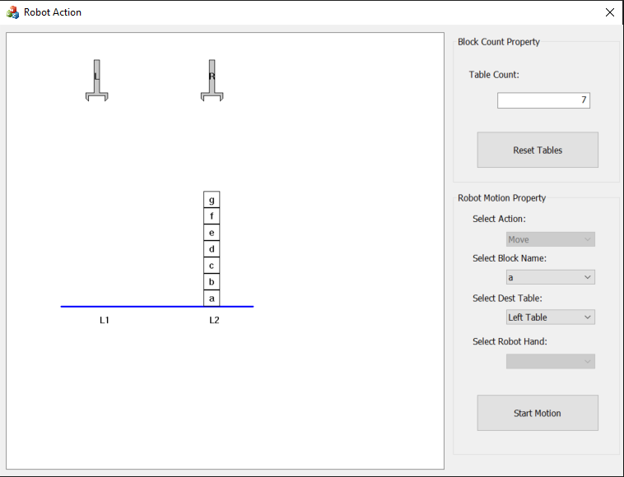
Right robotic arm
Left robotic arm
Location L2(Right side of table), where blocks will be placed
Here you can select the destination table where you want to move the boxes
Location L1(Left side of the table)

Slide 6
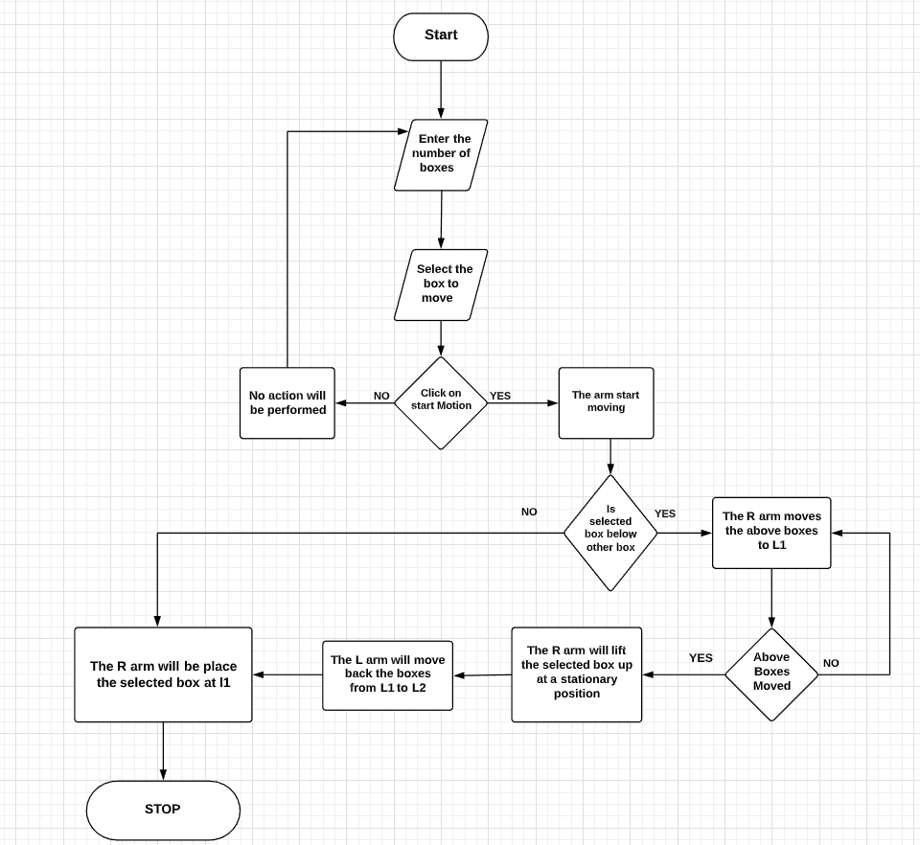
Flowchart showing working of my model

Slide 7
MFC:
Microsoft Foundation Class Library (MFC) is an "application framework" for programming in Microsoft Windows. MFC provides much of the code, which are required for the following −
Managing Windows.
Menus and dialog boxes.
Performing basic input/output.
Storing collections of data objects, etc

Slide 8
MFC extension:
C++ v14.26 MFC for v142 build tools (x86 & x64)
C++ v14.26 MFC for v142 build tools with Spectre Mitigations.
C++ ALT for the v142 build tools.
ALT and MFC for the v141 build tools.

Slide 9
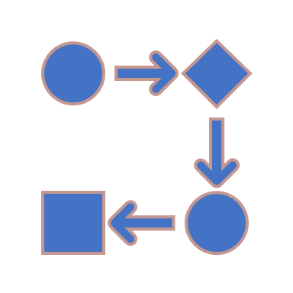
Memory leak
I have used various loops , so small process like one block movement has a lot of small movement , and each step requires drawing context.

Slide 10

Thank You

